Slide 1
CPA Exam Information
Presented by the USF Accounting Circle

Slide 2
Introductions
Kirsten Crame, Macc, CPA
Federal Tax Senior Accountant at Crowe Horwath
Aaron Parke, CPA
Audit Manager Rivero, Gordimer & Company
Notes:
We should have everyone’s designations after their name. We should each introduce ourselves, talk a little bit about where we work and what we do, and let the students know where we are on the CPA path.

Slide 3
Agenda
Why someone would want to be a CPA
Financially & economically secure profession
Wide range of career paths
CPA Exam topics & format
Steps to become a CPA
Deciding when to sit and for what state
Instructions and helpful websites
Study habits, tips & tricks, and balancing life while studying for the CPA exam

Slide 4
Reasons to Become a CPA
Respected Designation- The CPA license brings credibility to the accountant, and CPAs are experts in the eyes of the public. (ehow Money)
Occupational Mobility- There are many positions across industry and public accounting that are easy for a CPA to move in to. (BLS)
Financial Security- The average CPA makes an additional $720,000 over the course of their career. (New CPAs)
No Restrictions- Any accountant filing a report with the Securities and Exchange Commission (SEC) is required by law to be a CPA. (BLS)
Limitless Career Potential- Many CPA firms and companies will not promote a person above a certain level without the CPA designation.
Job Prospects- The CPA profession is one of the fastest growing professions according to the Department of Labor Statistics.
Recession-Proof Career Path- Audits, Tax Services and Other Financial Services are needed and required no matter how the economy is doing.

Slide 5
Respect for the CPA Designation
CPAs are respected and admired by their peers, clients, social circles and the business community. CPAs are known for:
Professionalism
Commitment to career
Technical aptitude
Experience and expertise
Ethical responsibility
Squidoo

Slide 6
Job Outlook
According to the Bureau of Labor Statistics Occupational Outlook Handbook:
“Employment of accountants and auditors is expected to grow 16 percent from 2010 to 2020, about as fast as the average for all occupations.”
“There has been an increased focus on accounting in response to corporate scandals and recent financial crises. Stricter laws and regulations, particularly in the financial sector, will likely increase the demand for accounting services as organizations seek to comply with new standards”
“The continued globalization of business should lead to more demand for accounting expertise and services.”
“Accountants and auditors who have earned professional recognition, especially as a Certified Public Accountants (CPA), should have the best prospects.”
Bureau of Labor Statistics

Slide 7
Job Growth Drivers
Retiring baby boomer CPAs
IFRS
Fewer accounting students in 1990s
Corporate governance regulations
Globalization
An increase in the number of businesses
Changing financial laws
Increased accountability
Volume and complexity of information
Bureau of Labor Statistics

Slide 8
Recession-Proof Career Path
Forbes ranked accounting management as third and accounting staff as fourth in an article on the top 10 recession-proof careers.
Business Week listed accounting fourth (accounting managers), fifth (accounting staff) and 10th (corporate accounting / finance departments).
The most recent report from JobFox on Trendhunter showed accounting as third.
CPA Success

Slide 9
CPA Statistics
According to the AICPA, CPAs earn 10-15% more than non-CPAs working in accounting-related jobs.
According to the U.S. Bureau of Labor Statistics, accountants and auditors rank in the top 20 occupations with the most demand for 2006-2016.
According to Robert Half, the CPA remains the most sought after designation by employers for accounting and finance professionals.
CPA Review Materials CPA Success

Slide 10
2016 Salary Ranges According to the Robert Half 2016 Salary Guide
These are national figures-to convert to Tampa, multiply by 98%.
Starting Salaries for 2016, up to 1 year of experience:
Firm Size | Public Accounting, Tax or Audit | Internal Auditor | General Accountant | Financial Analyst
Small | 49,000 - 58,750 | Not listed | 42,500 – 49,500 | 45,250 – 53,750
Medium | 52,250 – 64,750 | 52,250 - 65,500 | 44,750 – 54,750 | 48,250 – 59,000
Large | 59,000 – 72,500 | 55,000 - 67,000 | 47,500 – 57,750 | 50,000 - 64,000
Salary information for selected Corporate Accounting Positions for 2016. The salary range varies with company sales. These are base salary numbers that do not include bonuses and incentives.
CFO | 109,000 - 484,000
Treasurer | 107,250 - 470,000
Corporate Controller | 96,500 – 234,750
Tax Director | 120,500 – 184,000
Internal Audit Director | 119,000 - 279,500
Robert Half

Slide 11
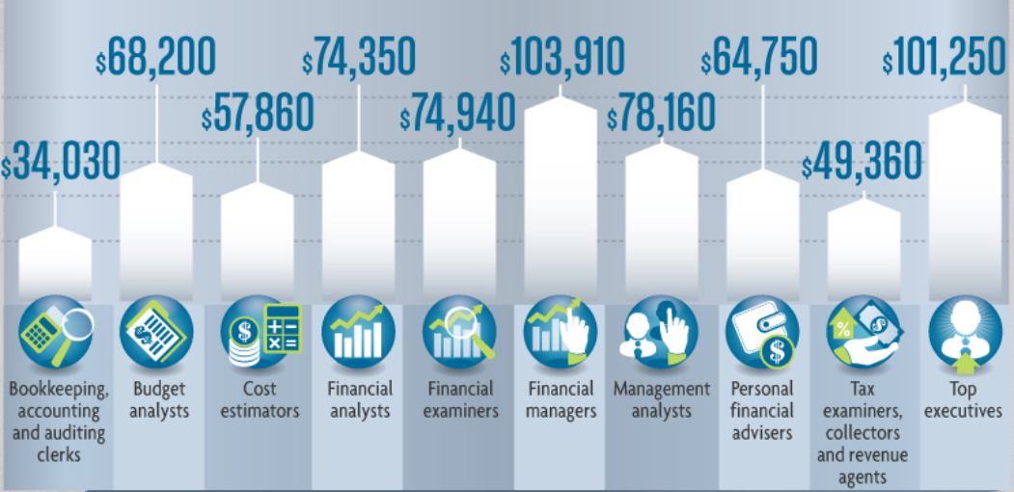
Median Pay for Accounting Related Positions
Becker http://www.masters-in-accounting.org/accountants/

Slide 12
CPA Career Paths
Many accountants become CPAs even if they have no desire to work in public accounting. Many CPAs will launch their career in public accounting, and then move into a different industry after a few years of experience. There are a broad range of career paths for CPAs including jobs in:
Public Accounting
Business and Industry
Government
Not for Profit
Education
AICPA

Slide 13
Public Accounting
Audits, Reviews, Compilations
Business Consultation
Financial Planning
International Financial Reporting
Information Technology
Management Consultation
Specialized Assurance Services
Tax Advisory Services
Tax Return Preparation
AICPA

Slide 14
Government
Budget Advisory
Spending priorities and tax programs
Efficiency Studies
FBI, CIA: Investigate White Collar Crime
SEC
Department of Treasury
AICPA

Slide 15
Not for Profit
Financial Budgeting
Consulting
Various Financial Leadership Positions
AICPA

Slide 16
Education
University Professor
Academic Research and Articles
Book Publications
Expert Witness
Business Applications of Accounting, Audit, Tax, Ethics and Information Technology
AICPA

Slide 17
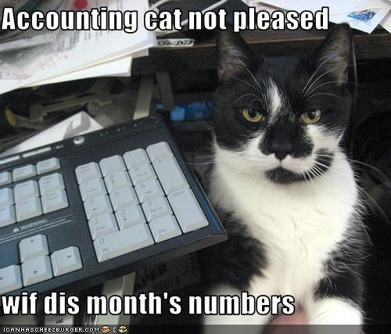
Business and Industry
Internal Auditor
Controller
Treasurer
Chief Financial Officer
Chief Executive Officer
Financial Analyst
According to Spencer Stuart: The number of CPA CFOs has risen from 29% to 45% since 2003. (Spencer Stuart)
AICPA

Slide 18
Form and Content of the Exam
The exam is split into 4 sections, which can each be taken on different days
AUD – Audit and Attestation (4 hours)
FAR – Financial Accounting and Reporting (4 hours)
REG – Regulation (3 hours)
BEC – Business Environment & Concepts (3 hours)
Each exam is 4 testlets
3 types of responses
Multiple choice
Task-based simulations
Essay
AICPA

Slide 19
Multiple Choice Questions
Multiple choice questions are broken into “testlets”
First 3 testlets of each section
Performance-based progression of testlets
First testlet is “moderate” difficulty
If you do well on the first testlet, the second will be more difficult
If you do not do well on the first testlet, the second will remain at “moderate” difficulty
Same for the third testlet
15-20% of the MC questions do not count at all
“Trial” questions to be used for scoring on future exams if they are deemed “valid” after the trial phase
AICPA

Slide 20
Multiple Choice Strategy
Answer every Question!
Wrong answers are not penalized.
You do not have to answer questions within a testlet in order.
Mark questions you do not know the answer to and go back once you answer questions you are more comfortable with.
Try not to waste thinking power on if the questions feel like they are getting more difficult.
AICPA

Slide 21
Task-Based Simulations
In AUD, FAR and REG, 6-7 independent task-based simulations (TBS) are the fourth testlet.
Each TBS provides a short narrative about a general topic, then asks a question in fill-in-the-blank or true-false format
Each TBS testlet will include at least one research question
A search engine of authoritative literature is provided for research.
AICPA

Slide 22
Essay Questions
The fourth testlet of the BEC section is a series of three essay questions.
Recommend to leave 15-20 minutes per question
Grading is based on writing skills as well as technical content.
Organization
Conciseness
Clarity
Use of the English language
Responsiveness to the question’s requirements
Appropriateness for the reader
A word processing tool with spell check is provided.
AICPA

Slide 23
Audit and Attestation (AUD)
Test format
60% multiple choice
Three 30-question testlets
40% simulations
One testlet containing 7 short task-based simulations
Covers a variety of topics relating to audits, reviews, and agreed upon procedure engagements of financial statements and other financial information
Internal Controls are tested intensely in this section.
AICPA Content Guide

Slide 24
Courses to help with AUD
Contemporary Issues in Audit
Accounting Information Systems
Any audit class
Any AIS class
Government & Not For Profit Accounting

Slide 25
Topic Breakdown of AUD
A – Engagement Acceptance and Understanding the Assignment
B – Understanding the Entity and its Environment
C – Performing Audit Procedures and Evaluating Evidence
D – Evaluating Audit Findings, Communications and Reporting
E – Accounting and Review Services Engagements
F – Professional Responsibilities
AICPA Content Guide
Notes:
Further breakdown for discussion:
Acceptance and planning:
Determine the nature and scope of the engagement
Consider the Firm’s system of quality control for policies and procedures pertaining to client acceptance and continuance
Communicate with the predecessor auditor
Establish an understanding with the client and document the understanding through an engagement letter or other written communication with the client
Consider other planning matter, including using the work of other auditors and considering the independence, objectivity and competence of internal audit
Identify matters and prepare documentation for communications with those charged with governance
Entity and Environment (E&E)
Determine materiality levels
Conduct a risk assessment discussion with audit team members, including discussion of fraud
Consideration of fraud, including inquiries with management
Perform risk assessment procedures
Consider additional aspects of the E&E, including industry, regulatory and other external factors; strategies and business risks; and financial performance
Consider internal control
Perform procedures to assess the control environment, including COSO and ELCs
Obtain and document understanding of SOPs
Perform walkthroughs
Assess IT effectiveness
Assess D&I of internal controls relevant to the audit
Identify key risks of GITC
Identify and assess FRAP controls
Consider service organizations
Consider the risk of management override
Assess and Document RoMM
Assess and Document special risks, including fraud, related parties, significant estimates, complex transactions and potential illegal acts
Audit Procedures and Evidence
Develop responses to identified risks
Perform audit procedures
Nature, timing and extent
Integrated audit of controls and F/S should accomplish both objectives (ICOFR and F/S opinions) simultaneously
Tests of control
Substantive procedures
Sampling
Analytical procedures
Confirmations
Examinations
Other tests of details, balances or journal entries
CAATs
Significant estimates
Fair value measurements
Unusual transactions
Contingencies
Obtain and review legal letters
Subsequent events
Management representations
Identify control deficiencies (SD, MW)
Identify communications required with TCWG
Evaluating Findings, Communications, Reporting
Perform analytics
Evaluate audit evidence and reach conclusions
Review work of others
Document misstatements identified
Consider going concern
Are F/S free from Material Misstatements?
Prepare communications, including audit report on FS, GAS reports, compliane reports, ICOFR reports, AUP reports, communications with TCWG, amongst others
Accounting and Review Services
Planning (similar to audit services) – determine who is the user of the ultimate reports to be issued
Obtain and document evidence to form conclusions
Prepare communications, including report in accordance with the engagement, restrictions on use of the reports, communicatins to management or TCWG
Professional Responsibilities
Ethics and Independence, with respect to:
AICPA Code of Ethics
PCAOB
SEC
GAO
DOL
SOX Title II and Title III
IFAC Code of Ethics
Other professional responsibilities
SOX Title I and Title IV

Slide 26
Financial Accounting and Reporting (FAR)
Test format
60% multiple choice
Three 30-question testlets
40% simulations
One testlet containing 7 short task-based simulations
Covers a variety of topics primarily pertaining to Intermediate Accounting I-III and Advanced Accounting course syllabi
The most mathematical section of the exam
AICPA Content Guide

Slide 27
Topic Breakdown of FAR
A – Conceptual Framework, Standards, Standard Setting and Presentation of Financial Statements
B – Financial Statement Accounts
C – Specific Transactions, Events and Disclosures
D – Governmental Accounting and Reporting
E – Not-for-Profit Accounting and Reporting
AICPA Content Guide
Notes:
Further discussion points:
Conceptual Framework, etc.
Process for setting standards and roles of the accounting standard setting bodies:
SEC
FASB
IASB
GASB
Conceptual framework, including financial reporting by businesses, not-for-profits and state & local governments
Financial reporting, presentation and disclosures
Balance sheet
Income statement
Stmnt of comprehensive income
Stmnt of changes in equity
SCF
Notes to FS
Consolidated/combined FS
IFRS adoption
SEC Reporting requirements
Other presentation, including OCBOA
Cash basis
Modified cash basis
Income tax basis
Personal FS
FS of EBP or trusts
Financial statement accounts: recognition, measurement, valuation, calculation, presentation and disclosures
Cash and cash equivalents
Receivables
Inventory
PPE
Investments, including fair value, AFS, HTM, joint ventures, equity method investments and property
Intangible assets, including goodwill
AP and accruals
Deferred revenue
Long term debt, including notes, bonds, convertible debt, modifications & extinguishments, troubled debt restructuring and debt covenant compliance
Equity
Revenue recognition
Costs and expenses
Compensation and benefits, including compensated absences, deferred comp, nonretirement post-employment benefits, retirement benefits and stock comp
Income taxes
Specific transactions, events and disclosures: recognition, measurement, valuation, calculation, presentation and disclosures
Accounting changes and error corrections
ARO and Environmental
Business combinations
Consolidation
Commitments, contingencies and guarantees
EPS
Disc Ops
Extraordinary or unusual
FV
Derivatives and hedges
FX
Impairment
Interim reporting
Leases
Equity vs. Liabilities
Nonmonetary transactions
Related parties
R&D
Risks and uncertainties
Segments
Software
Subsequent events
Transfers and servicing of financial assets
Governmental accounting and reporting:
Governmental accounting concepts, including basis of accounting, fund accounting, and budgetary accounting
CAFR statements, including Government-wide financials, fund financials (gov’tal, proprietary, fiduciary), notes, MD&A, RSI, combining statements and reconciliations used to derive government-wide statements
Financial reporting entity, including blended and discrete component units
Typical items and specific transactions:
Net assets and components
Fund balances and components
Capital assets and infrastructure
General LT liabilities
Interfund transfers
Nonexchange revenue transactions
Expenditures
Special items
Encumbrances
Accounting and reporting of governmental NPOs
Not-for-profit (nongovernmental) accounting and reporting:
Financial statements
Stmnt of financial position
Stmnt of activities
SCF
Stmnt of functional expenses
Typical items and specific transactions:
Support, revenues and contributions
Types of restrictions on resources
Types of net assets
Expenses, including depreciation and functional expenses
Investments

Slide 28
Courses that help with FAR
Intermediate 1, 2 & 3
USF does not require Intermediate 3, but the topics in this course are heavily covered in FAR.
Advanced Accounting
Government & Not for Profit Accounting
Accounting Information Systems
Cost 1 & 2

Slide 29
Regulation (REG)
Test format
60% multiple choice
Three 24-question testlets
40% simulations
One testlet containing 6 short task-based simulations
Covers a variety of topics pertaining to ethics, business law, and taxation
Heavy emphasis on taxation
~ 60% of this section
AICPA Content Guide

Slide 30
Breakdown of REG
A – Ethics, Professional and Legal Responsibilities
B – Business Law
C – Federal Tax Process, Procedures, Accounting and Planning
D – Federal Taxation of Property Transactions
E – Federal Taxation of Individuals
F – Federal Taxation of Entities
AICPA Content Guide
Notes:
Further discussion points:
Ethics, professional and legal responsibilities
Ethics and responsibilities in tax practice
Licensing and disciplinary systems (state boards and regulatory agencies)
Legal duties and responsibilities
Business Law
Agency rules, including formation, termination, authority of agents and principals, and duties/liabilities of agents and principals
Contracts, including formation, performance, assignments, breaches and remedies
Uniform Commercial Code
Debtor-Creditor relationships
Government regulation of business
Business structures
Federal Tax process, procedures, accounting and planning
Federal Tax Legislative process
Federal Tax Procedures, including due dates and extensions, IRS audits and appeals, judicial process, required disclosures, penalties and statutes of limitations
Accounting periods and methods, such as revenue recognition, inventory valuation, etc.
Tax return elections
Tax planning
Tax research and communication, including the authoritative hierarchy
Federal Taxation of property transactions
Types of assets
Basis and holding periods
Cost recovery (i.e. depreciation et al.)
Taxable/nontaxable sales and exchanges
Gains, losses and netting
Related parties
Estates and gifts
Federal taxation of individuals
Gross income, including characterization and inclusion/exclusion
Reporting of items from pass-through entities
Adjustments and deductions to arrive at taxable income
Passive activity losses
Loss limitations
Taxation of retirement plan benefits
Filing status and exemptions
Tax credits
AMT
Federal taxation of entities
Similarities and distinctions between types of entities
Differences between financial and tax accounting
C Corporations and their tax implications/benefits
S Corporations and their tax implications/benefits
Partnerships and their tax implications/benefits
Trusts and estates
Tax exempt organizations

Slide 31
Courses that help with REG
Business Tax
Individual Tax
Any tax electives
Business Law
Law and the Accountant

Slide 32
Business Environment and Concepts (BEC)
Test Format
85% multiple choice
Three 24-question testlets
15% written communication
Three written communication tasks on BEC topics
Covers a variety of topics pertaining to economics, markets, financial analysis, IT and planning
The broadest of the 4 sections, where less granular knowledge is required over greater amount of subject matter
AICPA Content Guide

Slide 33
Breakdown of BEC
A – Corporate Governance
B – Economic Concepts and Analysis
C – Financial Management
D – Information Systems and Communications
E – Strategic Planning
F – Operations Management
AICPA Content Guide
Notes:
Further Discussion:
Corporate Governance:
Rights, duties, responsibilities and authority of the Board of Directors, Officers and other employees with respect to financial reporting, internal control and enterprise risk mgmt
Control environment, monitoring and change control processes
Economic concepts and analysis
Changes in economic and business cycles – economic measures and indicators
Globalization and local economies
Market influence on business strategies
Financial risk management, including market, interest rate, currency, liquidity, credit, price and the means for mitigating/controlling such risks
Financial Management
Financial modeling, projections and analysis
Financial decisions
Capital and working capital management
Valuations (Fair Value)
Financial Transaction processes and controls
Information Systems and Communications
Organizational needs assessment, including data capture, processing and reporting
Systems design, including processes, controls, monitoring and policies
Security
Implications of internet use for businesses
Types of information systems and technology risks
Disaster recovery and business continuity
Strategic Planning
Market and risk analysis
Strategy development, implementation and monitoring
Planning techniques, including budgets, forecasts and projections
Operations Management
Performance management and impact of measures on behavior, including the impact of incentive compensation
Cost measurement methods and techniques
Process management
Approaches, techniques, measures and benefits
Roles of shared services, outsourcing and off-shore operations
Selecting and implementing improvement initiatives
Business process reengineering
Management philosophies and techniques for performance improvement
Project Management, including planning and implementation, roles of managers and members, risks, resources, cost and deliverables

Slide 34
Courses that help with BEC
Any economics courses
Any finance courses
Information Systems
Operations Management
Intermediate 1, 2 & 3
Financial Reporting & Professional Issues

Slide 35
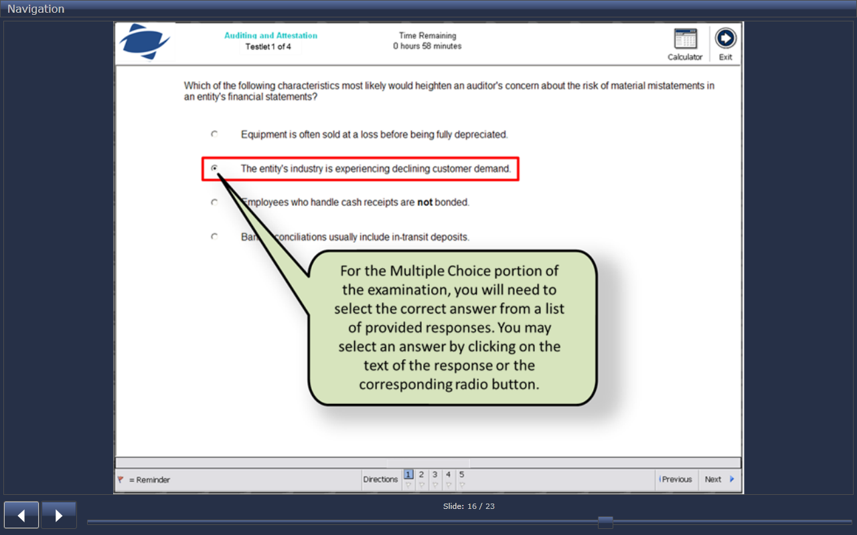
Multiple Choice Example Question/Format
This is a print screen from the AICPA Tutorial found on the AICPA website.
http://apps.aicpa.org/CBTeSampleTest/Tutorial_CBTe/Tutorial_Navigation/Tutorial_Navigation.html

Slide 36
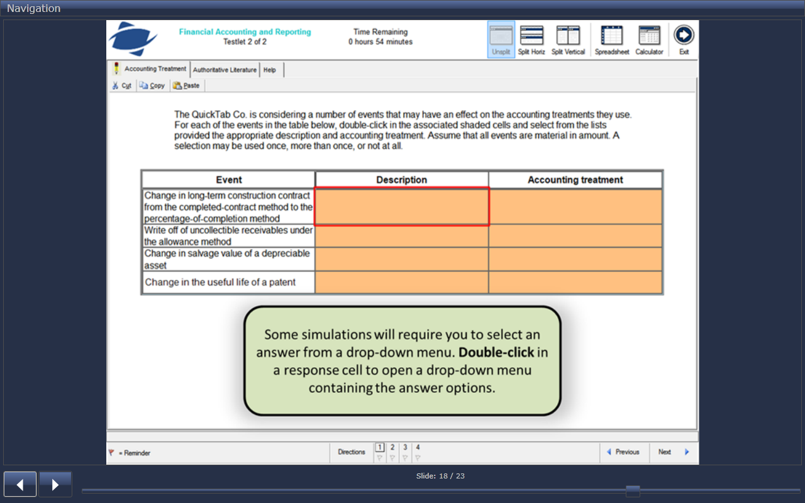
Simulation Example Question/Format
This is a print screen from the AICPA Tutorial found on the AICPA website.
http://apps.aicpa.org/CBTeSampleTest/Tutorial_CBTe/Tutorial_Navigation/Tutorial_Navigation.html

Slide 37
Entities to be Aware of
The AICPA makes the CPA exam, and the exam is the same for every state.
Rules on when candidates can sit for the CPA exam vary by state.
State Boards of Accountancy authorize candidates to sit for the CPA exam.
National Association of State Boards of Accountancy (NASBA) collects fees for the exam (in most states) , issues Notice to Schedule to candidates, and shares score information.
Prometric is the test center where candidates physically sit for the CPA exam.
The closest Prometric center to USF is on 56th street.
CPA exam candidates can test at any Prometric location regardless of which state they sit for.
AICPA Candidate Bulletin

Slide 38
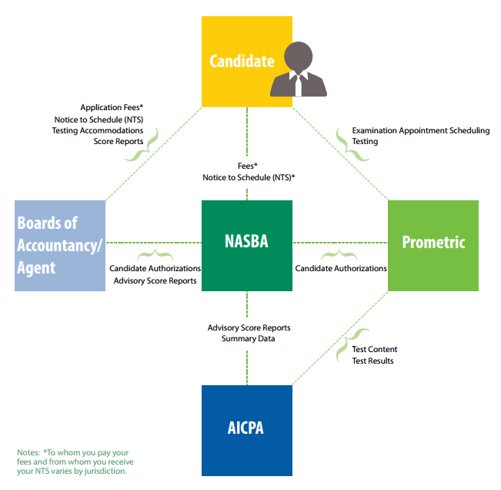
Visualization of Entities
AICPA Candidate Bulletin

Slide 39
Candidate Bulletin
Always review the most recent candidate bulletin before you take any CPA exam part.
The most recent version is from Oct. 2015
Easy to find on the internet- just Google it
The official candidate bulletin is from NASBA.
One of the main sources for this presentation
Link to the most recent candidate bulletin:
https://media.nasba.org/files/2011/09/CandidateBulletin_October2015.pdf

Slide 40
Which State to Sit For
Ultimately if you plan to practice in Florida, you will need to be a Florida CPA.
Florida has some of the most strict requirements to sit for the CPA exam.
Many students choose to sit for another state to allow them to sit earlier.
Many students want to sit as early as possible because their intermediate and other courses will be the freshest in their heads.
AICPA Candidate Bulletin

Slide 41
Georgia vs. Florida Comparison
 | Florida (licensure) | Florida (to sit) | Georgia (to sit)
Bachelors Degree | required | required | required
Semester Hours of Upper Level Accounting | 36 | 24 | 20
Semester Hours of Upper Level Business | 39 | 24 | 0
Semester Hours of Business Law included in Upper Level Business | 6 | 6 | 0
Total Hours | 150 | 120 | 120
Retest Fee per Section |  | $30-$60 | $30-$60
Exam Fees (includes Application Fee) |  | ~ $850 | ~ $880
Licensure By Endorsement Fee |  | $0 | $300
Application Type |  | Paper or Online | Online
Approval Processing Time |  | 1-3 months | 1-3 months
Becker Georgia, Becker Florida

Slide 42
Masters Vs. 5th Year
Students should consider getting a Macc Degree instead of 5th year.
Public accounting firms will tell you that they don’t care about the masters; they just want you to pass the CPA exam.
The masters will become more important in life when you are looking to move to industry or get promoted.
http://www.floridastudentfinancialaid.org/ssfad/bf/

Slide 43
Masters Vs. 5th Year Continued
You cannot teach college without a Masters. If it is in the realm of possibility that you’d like to adjunct teach, you will have to have a Masters.
Only Masters students can take 6000 level courses, and these challenging courses require the most creative/critical thinking. These courses will develop a student into a professional in a way that other courses will not.
http://www.floridastudentfinancialaid.org/ssfad/bf/

Slide 44
Masters Vs. 5th Year Continued
A bachelors degree is 120 credits, and a masters is 30. Candidates need 150 credits for CPA licensure, so it makes sense to get a masters degree.
MAcc students are way ahead of 5th year students regarding course registration priority. 5th year students cannot register until the first day of classes.
In the past, some students still chose to do a 5th year over a MAcc if they still had coursework Bright Futures will pay for. Previously Bright Futures would pay for 5000 level courses, but within the past year, that is no longer the case.
http://www.floridastudentfinancialaid.org/ssfad/bf/

Slide 45
Florida Requirements for Licensure The following is word for word from the Florida Department of Business Regulation website:
PASS ALL FOUR PARTS OF CPA EXAMINATION: with at least a 75% within 18 month rolling period.
ONE YEAR WORK EXPERIENCE: Must be under the supervision of a licensed CPA (This experience can be obtained prior to the application, while sitting for the exam or after all four parts of the exam has been passed. However, requirements to sit for the exam must be met before work experience commences.)
TOTAL REQUIRED HOURS: 150 semester or 200 quarter hours
TOTAL UPPER DIVISION ACCOUNTING HOURS: 36 semester or 54 quarter to include the following: Taxation, Auditing, Financial, Cost/Managerial and Accounting Info Systems.
TOTAL UPPER DIVISION GENERAL BUSINESS HOURS: 39 semester hours or 58 quarter hours to include the following: six (6) semester hours or eight (8) quarter hours of business law. One course can be at a lower lever (freshman or sophomore), the other course must be upper division (junior level or higher). Business Law 1 and Legal Environment of Business are often considered duplicate.
http://www.myfloridalicense.com/dbpr/cpa/licensure.html

Slide 46
Florida Work Experience Requirement The following is word for word from the Florida Department of Business Regulation website:
Work experience shall include any type of service or advice involving the use of accounting, attest, compilation, management advisory, financial advisory, tax, or consulting skills, all of which must be verified by a certified public accountant who is licensed by a state or territory of the United States and who has supervised the applicant. This experience is acceptable if it was gained through employment in government, industry, academia, or public practice and constituted a substantial part of the applicant's duties.
The experience must either average at least twenty (20) hours a week over no more than one hundred and four (104) weeks or average no more than forty (40) hours a week over no more than fifty-two (52) weeks. Reasonable vacation time and sick leave or other required absences may be permitted. The supervisor, in her or his report to the Department, shall certify that the applicant rendered such services as are customarily performed by full-time, regularly employed staff employees for a minimum of 2,000 hours gained over a period of not less than fifty-two (52) or more than one hundred and four (104) weeks. The sequence of the experience is considered immaterial, that is, whether the experience was secured before or after taking the examination, or partly before the examination and partly after the examination, provided the two periods combined equal at least one year.
http://www.myfloridalicense.com/dbpr/cpa/licensure.html

Slide 47
Example Timeline
This is the earliest point where students can become an Accounting Major officially
Start
Complete Intermediate Accounting One
Perform Accounting Internship
These hours won’t count since not FL CPA eligible.
Notes:
This timeline shows the most aggressive path that could be taken to obtain the CPA designation.

Slide 48
Example Timeline
This is the earliest point where students can become an Accounting Major officially
Students are eligible for some states to sit for the CPA exam, but not Florida.
Start
Complete Intermediate Accounting One
Complete Bachelors Degree in Accounting (120 credits)
Perform Accounting Internship
These hours won’t count since not FL CPA eligible.
Notes:
This timeline shows the most aggressive path that could be taken to obtain the CPA designation.

Slide 49
Example Timeline
This is the earliest point where students can become an Accounting Major officially
Students are eligible for some states to sit for the CPA exam, but not Florida.
Students are now eligible to sit for the CPA exam as Florida Candidates.
Start
**Sit for CPA Exam (18 month window)**
*Earn Work Experience (2 year window)*
Complete Intermediate Accounting One
Complete Bachelors Degree in Accounting (120 credits)
Perform Accounting Internship
Earn Credit for Law and the Accountant
These hours won’t count since not FL CPA eligible.
Internships after this point will count, but for most people, the clock will start when the full time job begins.
Notes:
This timeline shows the most aggressive path that could be taken to obtain the CPA designation.

Slide 50
Example Timeline
This is the earliest point where students can become an Accounting Major officially
Students are eligible for some states to sit for the CPA exam, but not Florida.
Students are now eligible to sit for the CPA exam as Florida Candidates.
150 credits are necessary for FL CPA Licensure.
Start
**Sit for CPA Exam (18 month window)**
*Earn Work Experience (2 year window)*
Complete Intermediate Accounting One
Complete Bachelors Degree in Accounting (120 credits)
Complete MAcc degree or 5th year (150 credits)
Perform Accounting Internship
Earn Credit for Law and the Accountant
These hours won’t count since not FL CPA eligible.
Internships after this point will count, but for most people, the clock will start when the full time job begins.
Notes:
This timeline shows the most aggressive path that could be taken to obtain the CPA designation.

Slide 51
Example Timeline
This is the earliest point where students can become an Accounting Major officially
Students are eligible for some states to sit for the CPA exam, but not Florida.
Students are now eligible to sit for the CPA exam as Florida Candidates.
150 credits are necessary for FL CPA Licensure.
Become a CPA!
Start
**Sit for CPA Exam (18 month window)**
*Earn Work Experience (2 year window)*
Complete Intermediate Accounting One
Complete Bachelors Degree in Accounting (120 credits)
Complete MAcc degree or 5th year (150 credits)
Complete 2000 hours of work
Perform Accounting Internship
Earn Credit for Law and the Accountant
Start working full time under a CPA
These hours won’t count since not FL CPA eligible.
Internships after this point will count, but for most people, the clock will start when the full time job begins.
Notes:
This timeline shows the most aggressive path that could be taken to obtain the CPA designation.

Slide 52
CPA Exam Test Windows
Test Months Non Test Months
January
February
March
April
May
June
July
August
September
October
November
December
http://www.aicpa.org/BecomeACPA/CPAExam/Pages/CPAExam.aspx

Slide 53
Test Timing & Notice to Schedule
Florida and Georgia NTS are each for 6 months
Just because you have 18 months to pass all 4 sections doesn’t mean it is supposed to take 18 months. Many candidates successfully pass all 4 parts in 6 months.
The 6 month window begins on or just before the day you receive your NTS.
You can time when you will receive your NTS by timing when you pay for the CPA exam.
Be aware of which months allow testing when planning your testing schedule.
AICPA

Slide 54
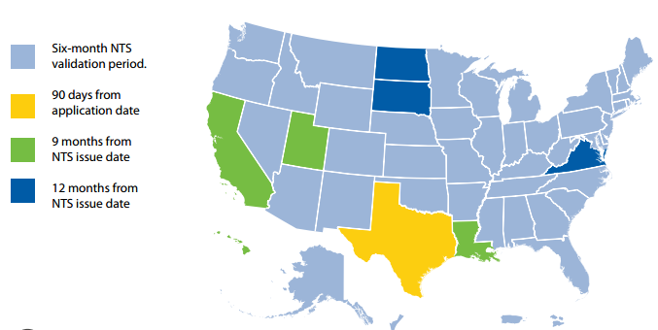
NTS Validation Period by State
http://nasba.org/files/2011/09/CandidateBulletin_102113.pdf

Slide 55
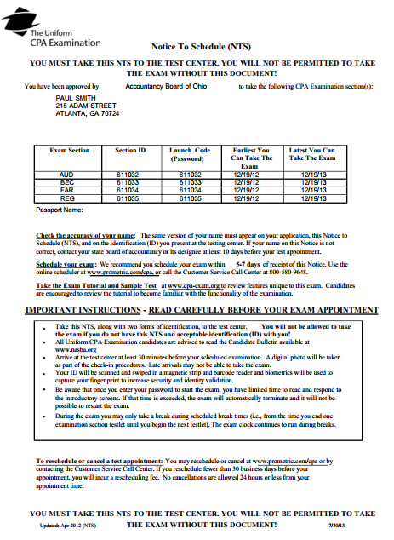
Sample Notice to Schedule
http://nasba.org/files/2011/09/CandidateBulletin_102113.pdf

Slide 56
To Apply to Sit as a Florida Candidate
Complete the paper application or online application found on the Florida Department of Professional Regulation Website: http://www.myfloridalicense.com/dbpr/cpa/documents/ApplicationPacketforCPAExamination.pdf
The online application is a new option.
Read the candidate bulletin found at www.nasba.org
Pay the $50 application fee.
Submit official transcripts.
The completed application, fees, and documentation should be sent to the FL Dept. B&P Regulation.
Florida Department of Business & Professional Regulation

Slide 57
To Apply to Sit as a Florida Candidate
Receive letter stating that you are eligible to sit for the CPA exam, and a payment coupon from NASBA. It could take 4 to 6 weeks to receive this letter (or even a bit longer). May arrive by mail or email.
Pay NASBA your exam fees. The cost for all four sections as a Florida candidate is about $800.
If you do not pay for all four sections at once, then you will pay an additional $30-$50“re-test” fee per section, even if you are not re-testing that particular section.
Only pay for as many sections as you plan to take within the next 6 months.
Carefully choose when to pay your fees. Once your fees are paid, you will be issued a “Notice to Schedule.” If you select to have your NTS emailed to you, it could come to you in as few as 2 days. If you have it mailed, it could take 10 days. It is important to choose when to pay carefully so that your NTS will arrive at a good time that matches your planning when it comes to timing the exams.
Becker, Florida and NASBA

Slide 58
To Apply to Sit as a Georgia Candidate
Candidates apply online directly through NASBA. www.nasba.org
Read the candidate bulletin found at www.nasba.org
The application fee and registration fee for all 4 sections totals about $880. If you do not pay for all four sections at once, then you will pay an additional “re-test” fee per section, even if you are not re-testing that particular section.
Only pay for as many sections as you plan to take within the next 6 months.
Carefully choose when to apply and pay your fees. Once your fees are paid, you will be issued a NTS. It is important to choose when to pay carefully so that your NTS will arrive at a good time that matches your planning when it comes to timing the exams.
Submit your transcripts to:
CPA Examination Services – GA PO Box 198469 Nashville, TN 37219
Becker, Georgia and NASBA

Slide 59
Scheduling the Exam
Once a candidate receives his or her Notice to Schedule, the candidate needs to contact the Prometric location where they’d like to physically take the test.
Test appointments at Prometric can be easily scheduled online. Candidates can test in the morning, afternoon or evening Monday- Saturday.
Test appointments can only be scheduled once a candidate has their NTS, and the NTS needs to be brought to the exam.
Prometric will provide candidates with small lockers on test day. Candidates are not allowed to bring anything into the exam including a watch.
The exam will have its own calculator and spreadsheet function.
Prometric will provide candidates with 2 double sided, laminated, colored sheets called “noteboards” and a fine point marker.
http://nasba.org/files/2011/09/CandidateBulletin_102113.pdf

Slide 60
Additional Prometric Considerations
If you are late to the exam, they will not allow you to test.
You must have two valid forms of ID; one must include a picture.
Prometric will take a photo of you and capture your fingerprint.
Special accommodations can be made-see the candidate bulletin for more information.
You will be offered breaks upon completeing each testlet, but do not have to take a break. The clock keeps running during breaks.

Slide 61
Rescheduling
You can reschedule for a fee. Avoid doing this.
This does not affect your NTS expiration date.
30 days or more before the exam: $0 fee
6-29 days before the exam: $35 fee
5 days – 24 hours before the exam:
AUD $76
BEC $57
FAR $76
REG $57
http://nasba.org/files/2011/09/CandidateBulletin_102113.pdf

Slide 62
Receiving Scores
Candidates can see their scores online through the NASBA website.
There is a new option for candidates to have their score emailed to them.
Scores will also be mailed to candidates. The numerical score will be listed, and the letter will state if credit has been awarded.
If the score is 74 or below, credit is not given and an analysis of that particular candidates strengths and weaknesses will be given to them in the form of a chart. This chart will let the candidate know which test areas they are strong, average and weak in compared to other CPA candidates.
Candidates can take each exam part only once each window.
http://nasba.org/files/2011/09/CandidateBulletin_102113.pdf

Slide 63
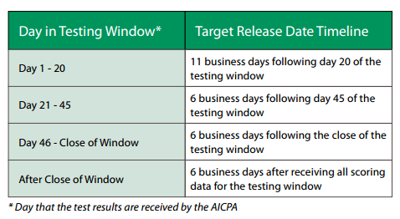
New CPA Exam Score Release Timeline
Prior to October 2011 candidates had to wait 1-2 months for their CPA scores.
NASBA now releases scores based on this table:
Not all scores will always be released by the target date
http://nasba.org/files/2011/09/CandidateBulletin_102113.pdf

Slide 64
After the Exam is Passed
All four sections of the CPA exam must be passed within 18 months.
Florida candidates will receive a packet to complete once they pass all four sections.
Once the experience requirement is met, candidates must submit the Certificate of Work Experience form to the FL Department of Business and Professional Regulation.
The form can be found here: http://www.myfloridalicense.com/dbpr/cpa/documents/CertificationofWorkExperiencerevised1009.pdf
Georgia candidates (or candidates from other states) must complete and send to the FL Department of Business and Professional Regulation the Licensure by Endorsement form.
The process detailed here: http://www.myfloridalicense.com/dbpr/cpa/Licensure3.html
Licensure by Endorsement has a $300 fee.
Georgia candidates (or candidates from other states) must complete the Authorization for Interstate Exchange of Examination and Licensure Information found here: http://www.myfloridalicense.com/dbpr/cpa/documents/CPA-5012.pdf
This form is completed by you and sent to NASBA.
Florida Department of Business & Professional Regulation

Slide 65
Mailing of the License
If you have questions regarding the status of your application at any point in the process, you can call the Florida Division of Certified Public Accounting at 850-487-1395.
Once all paperwork has been submitted and processed, new CPAs will receive their CPA license through the mail.
The first item to arrive will be a small card.
The second item will be the large CPA license to hang on your wall.
It will take at least a month to receive your license.
Florida Department of Business & Professional Regulation

Slide 66
Coming Soon on the CPA Exam
Proposed changes would enhance higher-order skills testing.
Changes will be announced Spring 2016 and take effect during 2017.
BEC will add 4 or 5 task-based simulations.
AUD, FAR & REG would have 8 or 9 task-based simulations.
Total exam time will increase from 14 to 16 hours: 4 hours for each section. Price is expected to increase as well.
Score weight for AUD, FAR & REG will be 50% multiple choice, 50% task-based simulations.
Score weight for BEC will be 50% multiple choice, 15% written communication, 35% task-based simulation.
Current score weight is AUD, FAR & REG 60% MC / 40% TBS, and BEC 85% MC, 15% TBS.
http://www.aicpa.org/BecomeACPA/CPAExam/nextexam/DownloadableDocuments/Next-CPA-Exam-Exposure-Draft-20150901.pdf

Slide 67
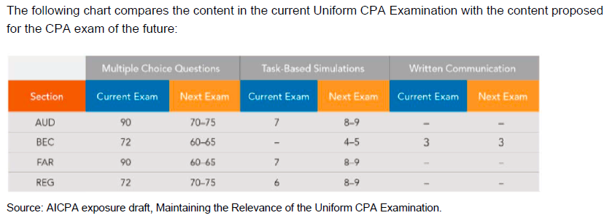
Coming Soon on the CPA Exam
http://www.aicpa.org/BecomeACPA/CPAExam/nextexam/DownloadableDocuments/Next-CPA-Exam-Exposure-Draft-20150901.pdf

Slide 68
CPA Exam Policy on New Pronouncements
Accounting and auditing pronouncements are eligible to be tested on the Uniform CPA Examination in the testing window beginning six months after a pronouncement's effective date, unless early application is permitted. When early application is permitted, the new pronouncement is eligible to be tested in the window beginning six months after the issuance date. In this case, both the old and new pronouncements may be tested until the old pronouncement is superseded.
Changes in the federal taxation area, the Internal Revenue Code and federal taxation regulations may be included in the testing window beginning six months after the change's effective date or enactment date, whichever is later.
For all other subjects covered in the Regulation (REG) and Business Environment and Concepts (BEC) sections, materials eligible to be tested include federal laws in the window beginning six months after their effective date, and uniform acts in the window beginning one year after their adoption by a simple majority of the jurisdictions.
http://www.aicpa.org/BecomeACPA/CPAExam/ExaminationContent/NewPronouncementPolicy/Pages/new_pronouncements.aspx

Slide 69
AICPA Free Resources
Navigate through the tutorial- it looks exactly like the real CPA exam and demonstrates all the tools available.
Take the sample tests- they include multiple choice questions and simulations from each section.
Subscribe to the 6 months of free professional literature used on the CPA Exam
AICPA Professional Standards
FASB Original Pronouncements
FASB Accounting Standards Codification

Slide 70
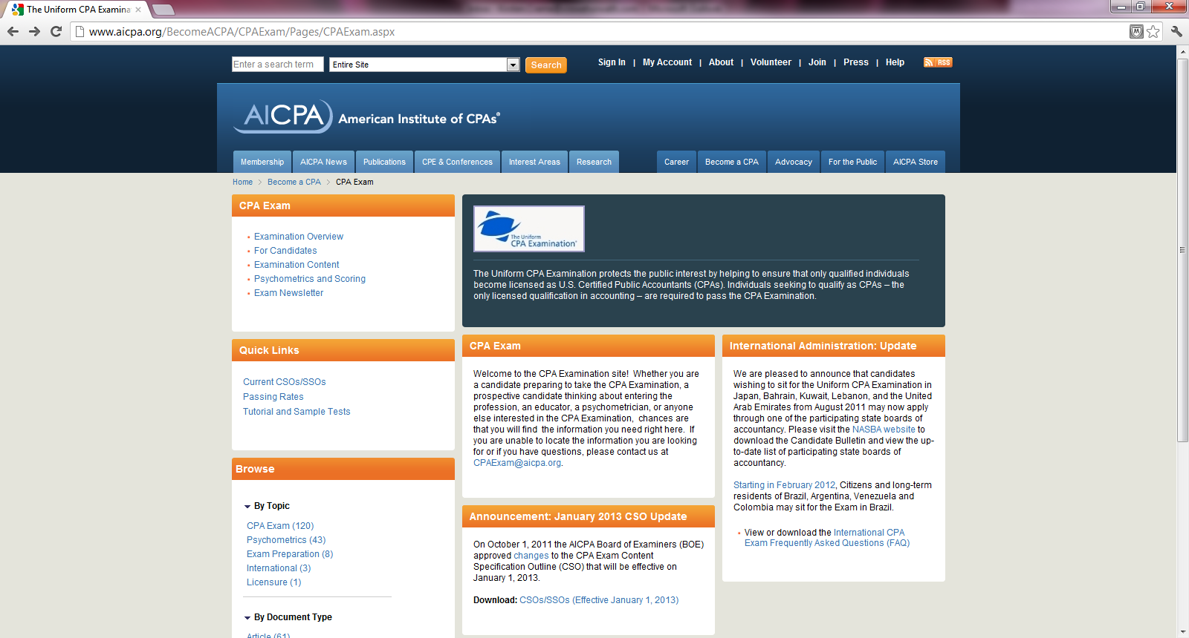
AICPA Website

Slide 71
Study Time Commitment
According to Becker’s general guidelines:
100 study hours for each AUD & BEC
200 study hours for each FAR & REG
Kirsten’s personal plan per each part-
3-4 hours per day 4-5 days a week for a month
I did the USF live review program (no longer offered)
Used Becker for AUD since didn’t pass first time.
Becker Fast Pass is an intense option
Finish all 4 parts in 12 weeks
Don’t work or have other commitments

Slide 72
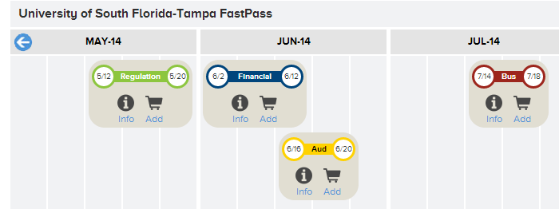
Study Time Commitment
Becker Fast Pass takes 12 weeks during summer
Kirsten’s thought- if I had to do it all over again, I would have done Becker Fast Pass.
Disclosure- I am NOT compensated in any way by Becker!
http://cpaexamprep.com/budgeting-time-for-cpa-exam-courses-depends-upon-personal-circumstances/

Slide 73
Study Habits for the CPA Exam
Going into the process of preparing for the CPA exam without a study plan is one of the easiest ways to struggle with passing the exam
Just like with studying for anything, each individual has their own way of studying that works best – identify yours early
Before you start studying for the CPA exam, schedule the CPA exam part(s) you want to take within the next six months
If you don't, you'll probably never get started!

Slide 74
Study Habits for the CPA Exam
Find a CPA exam review format and a study plan early and stick with it
Set aside the right amount of time to study and anyone can pass
Passing the CPA exam isn't about being the most technical accountant
If possible, have a consistent time set aside to study for the CPA exam each day without distractions
Break your studying down into parts making sure you master each part before going to the next one
Do the prep work before doing multiple choice questions and working simulations, but make doing the multiple choice questions and simulations a top priority
A general rule is that for every hour of prep work you do, spend two – three hours doing multiple choice or practice simulation questions

Slide 75
Study Habits for the CPA Exam
When doing multiple choice questions and practice simulations, read all of the answer choices and explanations
Make an effort to take very detailed notes from your prep work, your multiple choice questions, and your practice simulations
Prepare for the CPA exam in conditions that are similar to the test day environment
Keep track of your progress on a daily basis
Know a little about a lot of the topics
The CPA exam has often been referred to as being "a mile wide, and an inch deep"

Slide 76
CPA Exam Tips and Tricks
Start taking the CPA exam as soon as you complete the accounting classes and other requirements necessary to take the exam
Know the format of each section of the CPA exam before you start studying. It will make studying for the exam a lot easier
Once you schedule a part of the exam, don't reschedule unless an extenuating circumstance arises
Once you start taking the CPA exam, keep going – Don't lose momentum!

Slide 77
CPA Exam Tips and Tricks
Go into the testing center with your own "game plan" for finishing the CPA exam part you are taking
Finish the CPA exam while you're in school!
Know the resources that are available to you from the entities involved in the CPA exam process
AICPA Free Resources
Use websites like www.cpanet.com , www.another71.com , and www.goingconcern.com for resources from the CPA candidate perspective

Slide 78
Balancing Life While Studying for the CPA Exam
According to the AICPA, maintaining balance in your life comes down to prioritizing four areas:
Work
Family and Friends
Community
Health
AICPA

Slide 79
Balancing Life While Studying for the CPA Exam
Five steps to achieving work-life balance from a CPA candidate's perspective
Figure out what really matters to you in life
Drop unnecessary activities
Protect your private time
Accept help to balance your life
Plan fun and relaxation
Another 71
Notes:
Crunch time- work questions, don’t watch lectures

Slide 80
Key Take-Aways
The CPA exam is an endurance test that any accounting student can pass with proper preparation.
Dedicate yourself to passing the exam
Seriously study using test conditions
Finish the CPA exam while you are in school
Strongly consider the MAcc degree or MBA
Put thought into the timing of your exams
Coincide with classes you are enrolled in
Account for non-test months

Slide 81
Resources
Accounting Zone http://www.accountingzone.com/2010/04/al-capone-was-caught-by-an-accountant.html
AICPA 2011 Overview http://www.aicpa.org/BecomeACPA/CPAExam/ForCandidates/HowToPrepare/DownloadableDocuments/New_2011_CPA_exam_guide_to_CBTe.pdf
AICPAhttp://www.experience.com/alumnus/article?channel_id=accounting&source_page=additional_articles&article_id=article_1132246759771
AICPA Candidate Bulletin https://media.nasba.org/files/2011/09/CandidateBulletin_October2015.pdf
AICPA Content Guide http://www.aicpa.org/becomeacpa/cpaexam/examinationcontent/contentandskills/downloadabledocuments/csos-ssos-effective.7-1-11.pdf
Another 71 http://www.another71.com/balancing-work-life-and-the-cpa-exam
Becker Florida http://www.becker.com/accounting/cpaexamreview/florida/
Becker Georgia http://www.becker.com/accounting/cpaexamreview/georgia/
Biz Journals http://www.bizjournals.com/louisville/stories/2010/05/24/focus1.html
Bureau of Labor Statistics http://www.bls.gov/oco/ocos001.htm http://www.bls.gov/oes/current/oes132011.htm#(9)
CPA Review Materials http://www.cpareviewmaterials.com/news/57/Why-Become-a-CPA%3F.html
CPA Success http://www.cpasuccess.com/2009/01/recession-proof-jobs---careers-promising-prosperity-and-stability-in-2009---trend-hunter-the-global-recession-was-realized.html
Ehow Money http://www.ehow.com/info_8537391_disadvantages-hiring-noncpas.html
Florida Department of Business & Professional Regulation https://www.myfloridalicense.com/CheckListDetail.asp?SID=&xactCode=1010&clientCode=0101&XACT_DEFN_ID=2759
Journal of Accountancy http://www.aicpa.org/BecomeACPA/CPAExam/nextexam/DownloadableDocuments/Next-CPA-Exam-Exposure-Draft-20150901.pdf
New CPAs http://www.newcpas.com/2009/03/top-3-reasons-to-become-a-cpa.html
NASBA Georgia http://www.nasba.org/exams/cpaexam/georgia/
Robert Half International http://www.rhi.com/SalaryGuides

